Slide 1



WIP
WIP
Bernardo Klein, Taras Leshchenko, Archer (Zi Xing) Wei

Slide 2
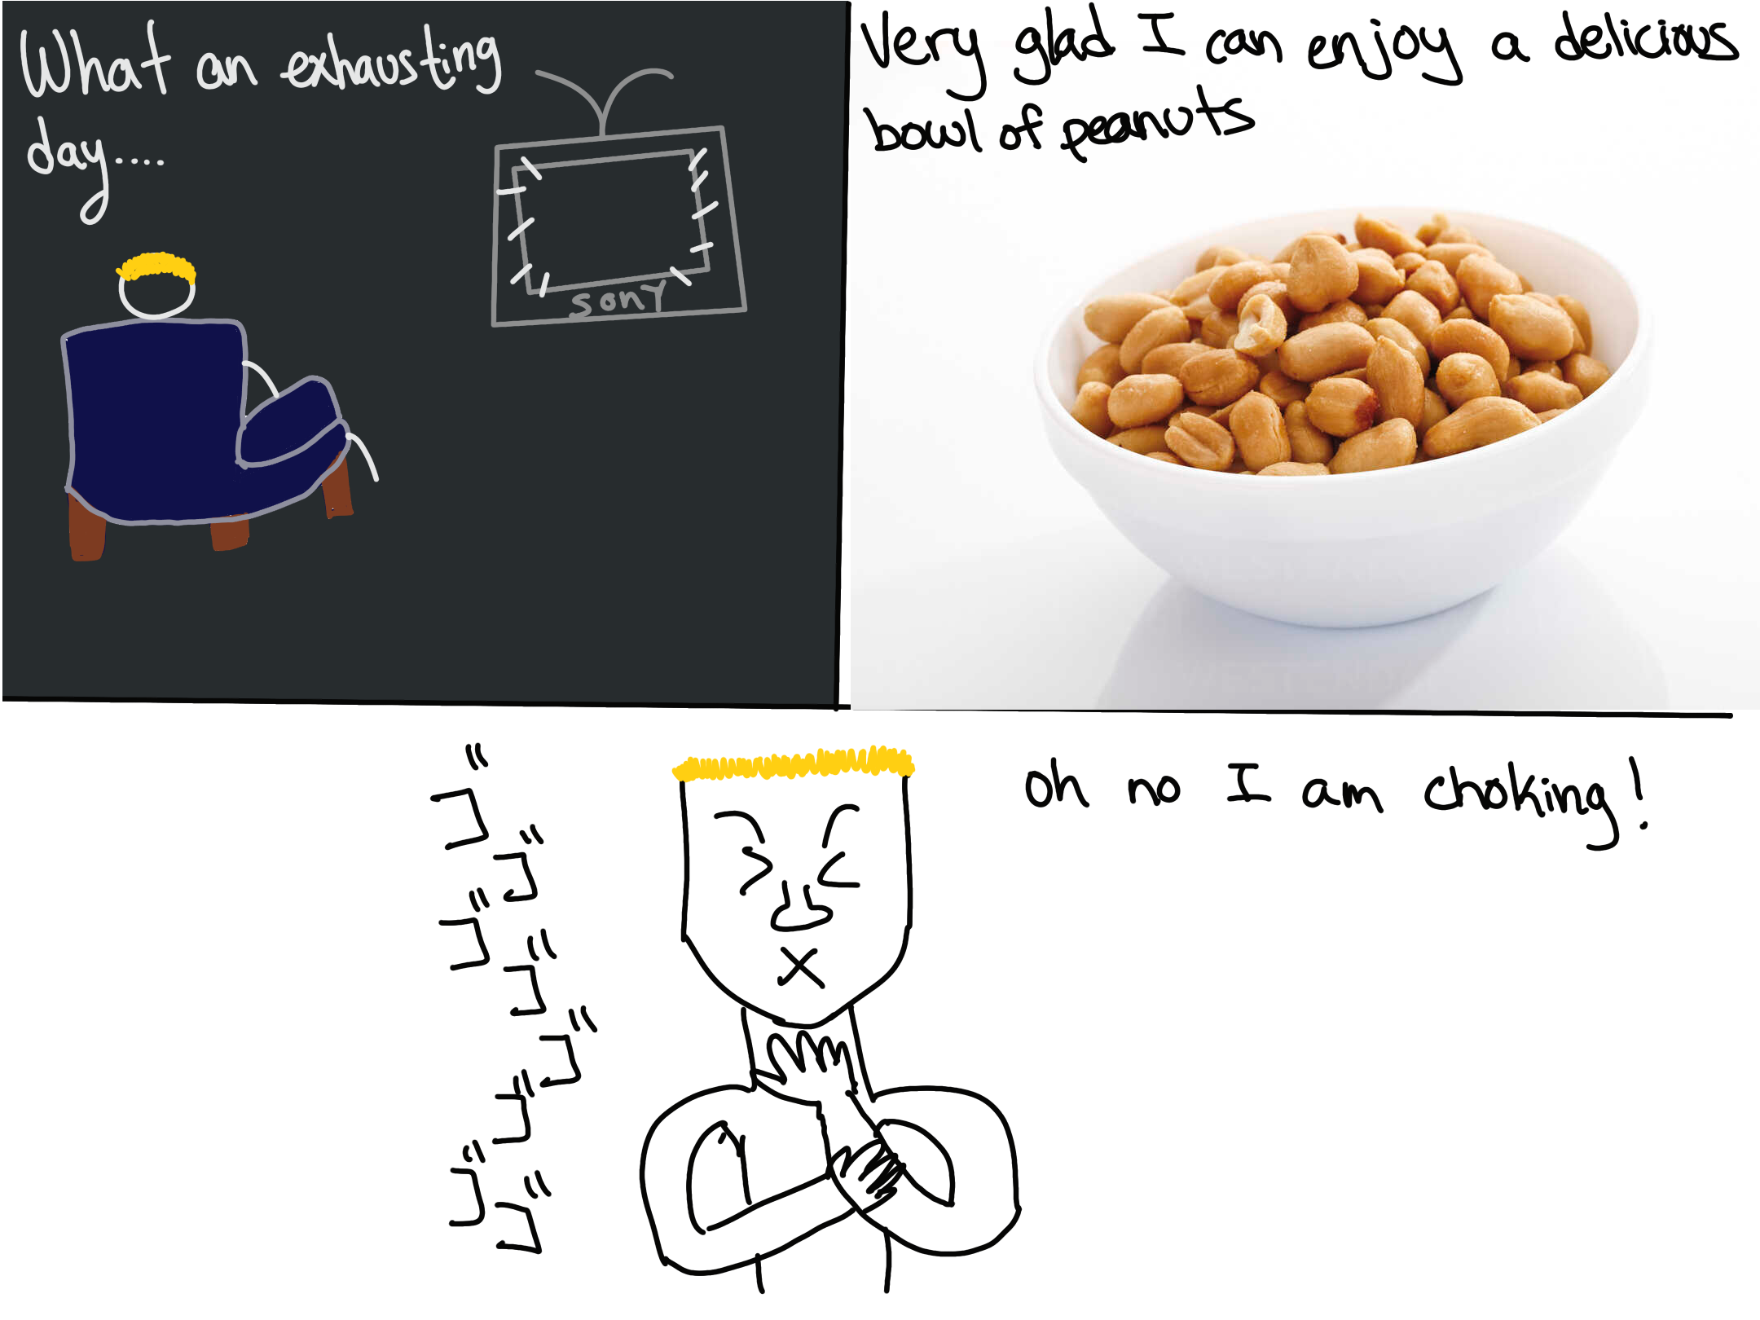

Slide 3
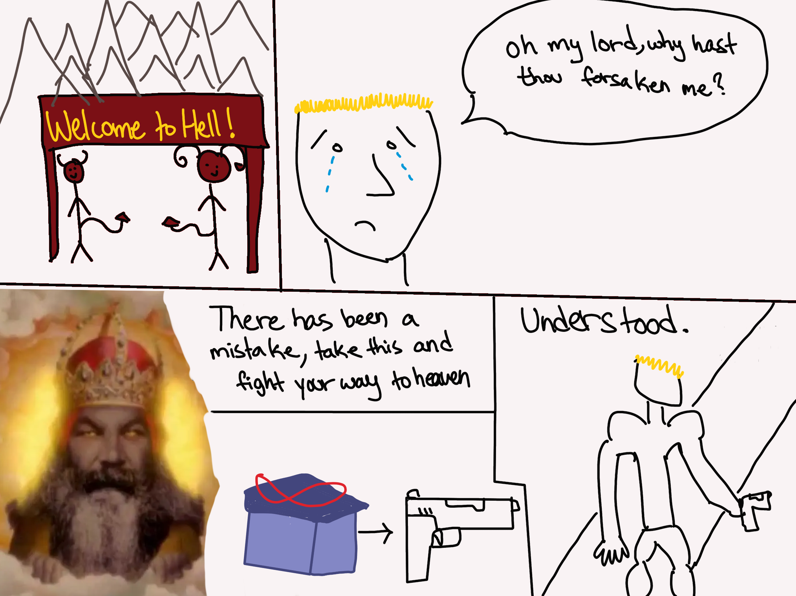

Slide 4
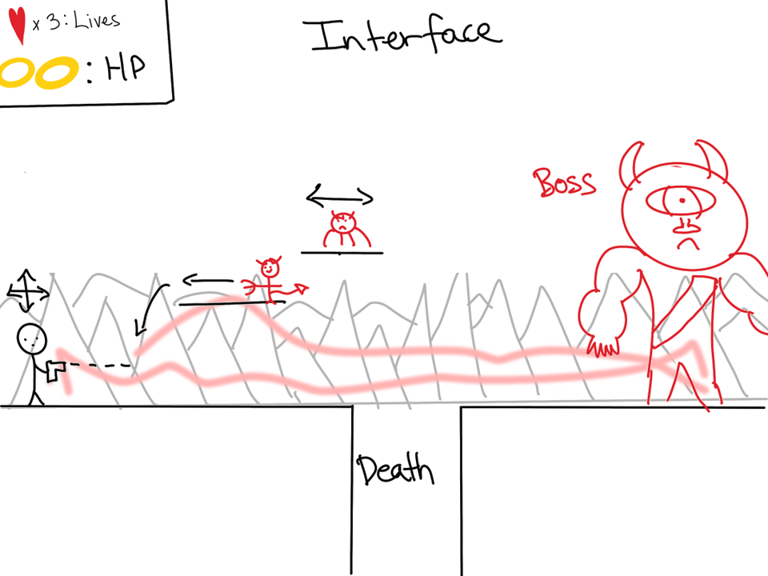

Slide 5
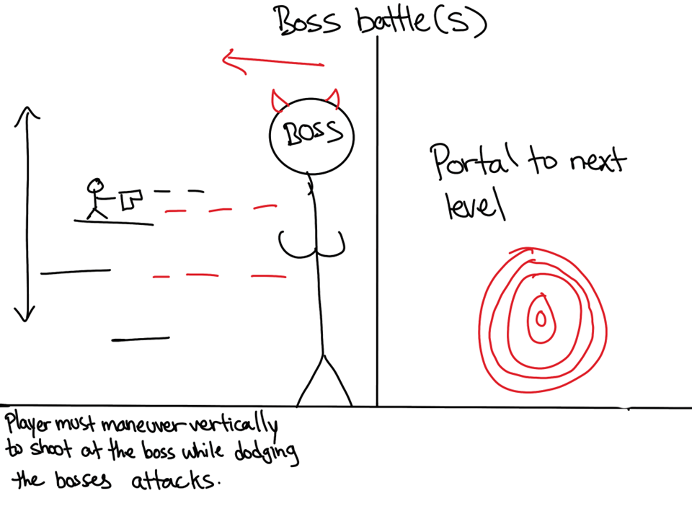

Slide 7
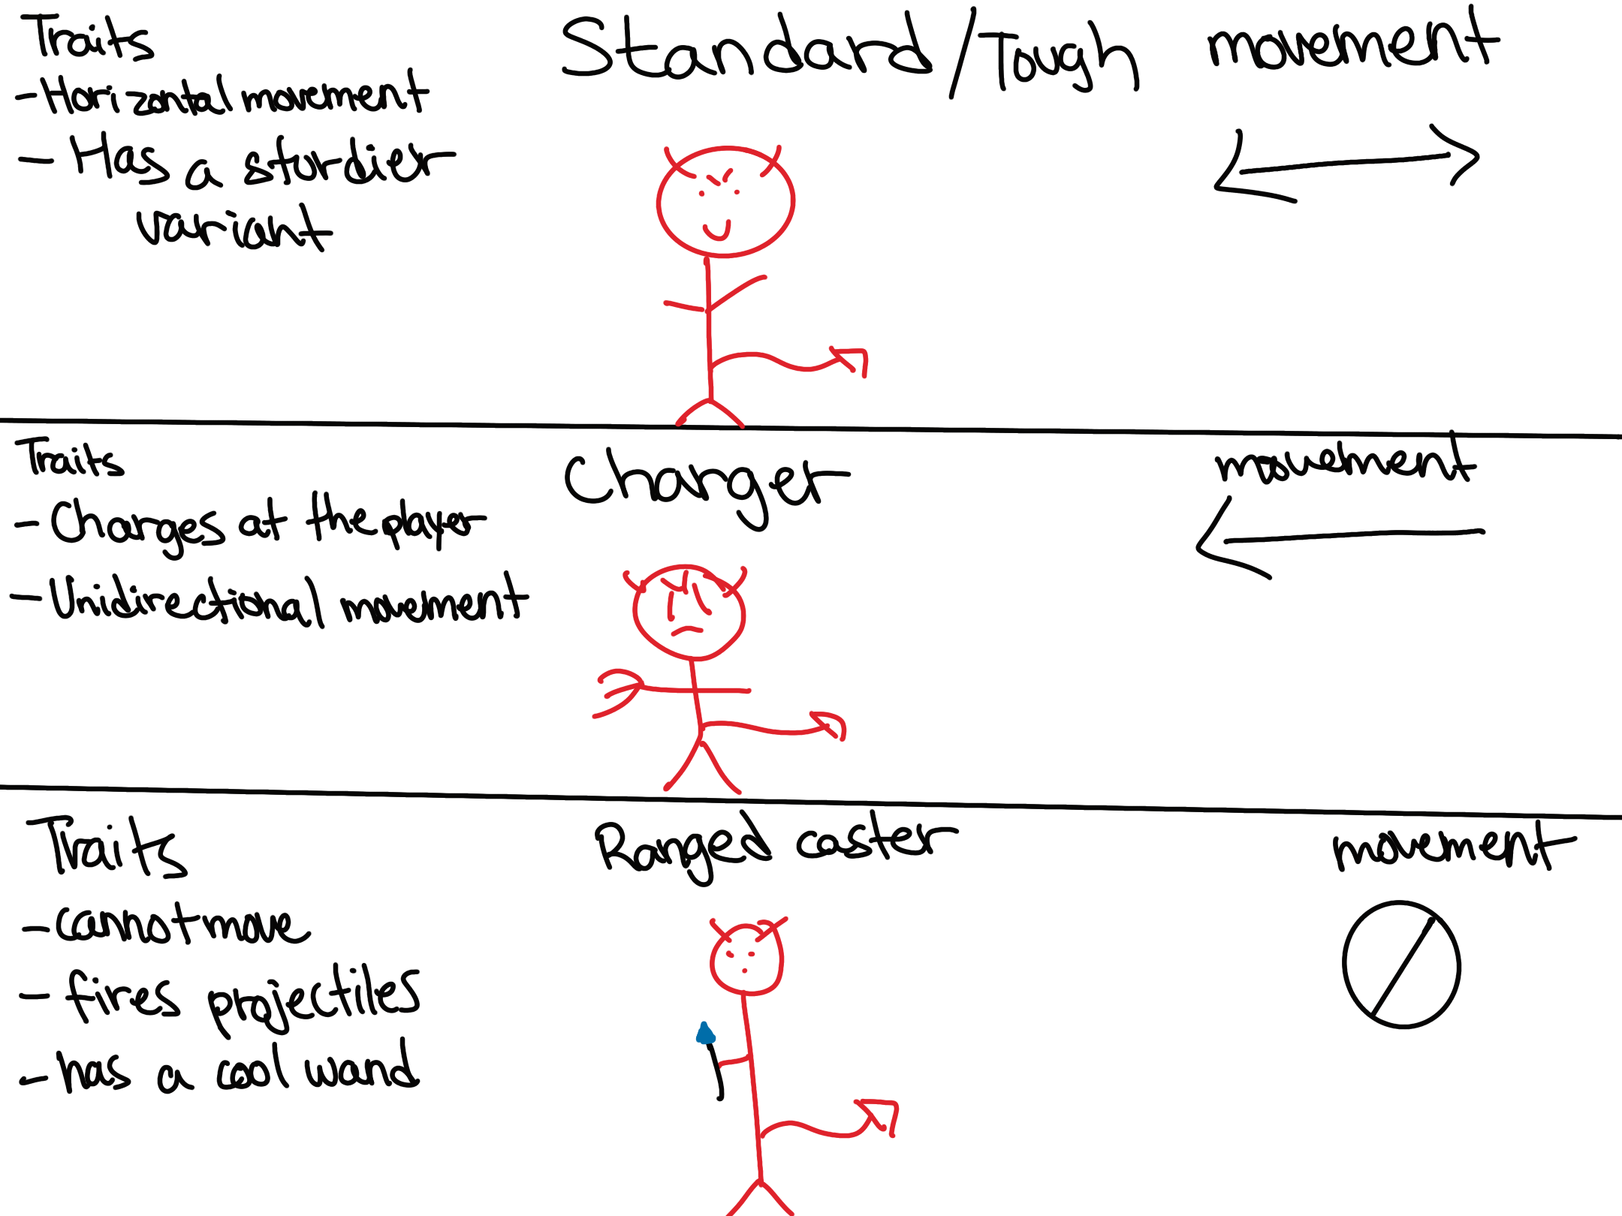

Slide 8
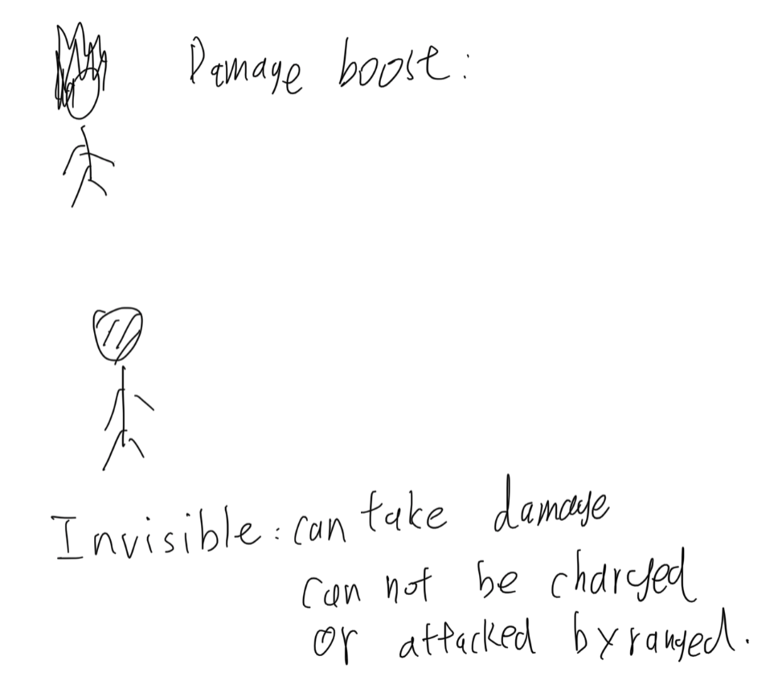

Slide 9
Thank you.

